Slide 1




Bolt's Business Data Insights
By: Ayman Altaweel
On: April 2024

Slide 2


Content
01
Introduction
02
Methodology
03
Insights
04
Strategic Recommendations
05
Conclusion

Slide 3


INTRODUCTION
We will delve into Bolt Business, the B2B arm of Bolt, aiming to extract valuable insights from acquisition and ordering data.
Our goal is to provide strategic growth recommendations tailored for Bolt's Business country managers, directors, and VP.

Slide 4







Methodology
01 Data Collection
Acquisition and ordering data were collected.
Also, Merged into a unified analytical dataset.
02 Data Cleansing
Renamed columns to lowercase with underscores.
Adjusted column names for consistency.
Handled null values and duplicates.
Ensured relevant data types.
Sorted the data for clarity.
03 Feature Engineering
Monetization KPIs: Average Order Value (AOV) and Average Revenue Per User (ARPU).
04 Exploratory Data Analysis (EDA)
Explored trends and patterns in the data.
05 Visualizations & Insights
06 Strategic Recommendations

Slide 5
INSIGHTS

Slide 6


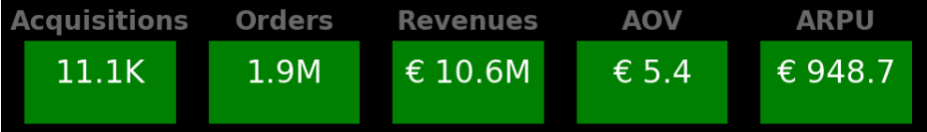
Insight 1: Overall KPIs

Slide 7

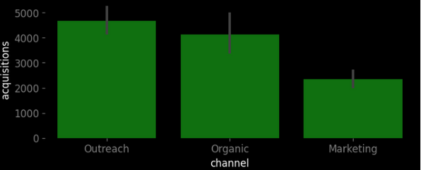
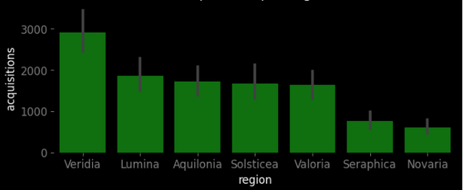
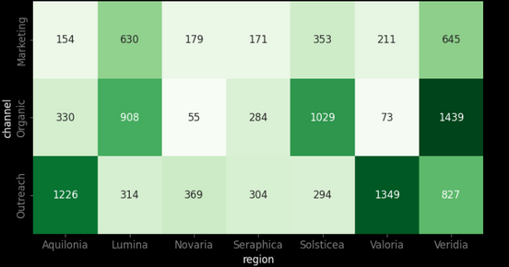
Insight 2: Acquisitions
Per Channel
Per Region
By Region and Channel
Outreach & Organic channels outperform Marketing by about 2x
Veridia shows strong acquisitions, while Seraphica & Novaria lag behind
Outreach got 70-80% of Aquilonia & Valoria acquisitions
Organic is for acquisitions in Lumina, Solsticea & Veridia

Slide 8
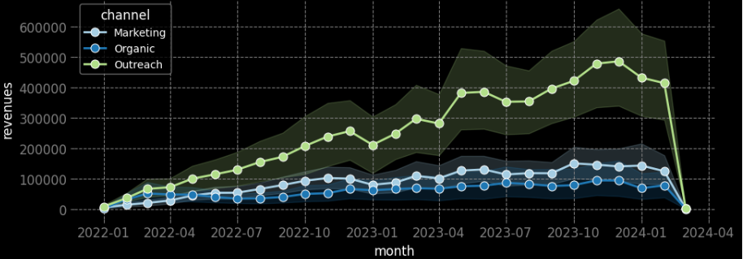
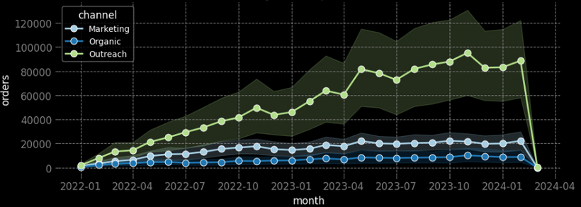
Insight 3: Channel Feasibility
Monthly Revenues
Monthly Orders
Companies acquired via Outreach exhibit significantly higher revenues and orders, nearly 3x more than others

Slide 9
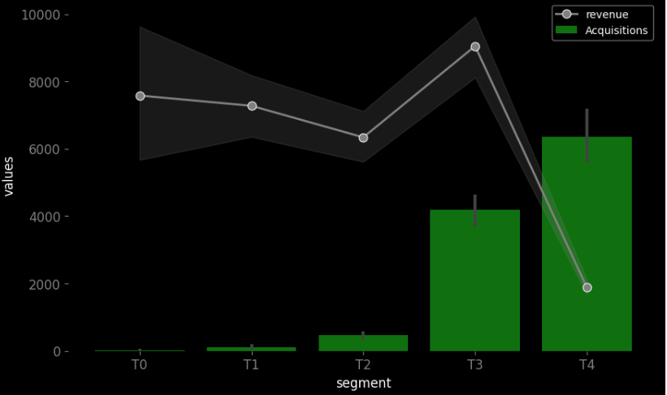
Insight 4: Segment Profitability
Monthly Revenues
Segment-T4 accounts for 70% of acquisitions but contributes only 15% of revenues
The other segments especially Segment-T3 are the most profitable, generating around 85% of revenues, aligning with the Pareto principle

Slide 10
STRATEGIC
RECOMMENDATIONS

Slide 11






Strategic Recommentaions
Enhancing Acquisition by Marketing
Targeted Acquisitions by Channel
To acquire more companies and grow our business even more
Outreach --> Aquilonia & Valoria
Organic (Awareness) --> Lumina, Solsticea & Veridia
Due to significant growth feasibility in these regions
Penetrating Seraphica & Novaria
Retain Segment-T3
They got low acquisitions and more likely there is room to grow in these regions
We may include them in loyalty programs to maintain their high profitability
Prioritize Outreach Channel
Invest more in Segment-T4
It has shown 3x times better ROI
Huge potential base (70%) for revenue streaming
Promotions may be good to monetize them

Slide 12
CONCLUSION
In summary, our analytics project has yielded actionable recommendations for driving the growth of Bolt Business, with a focus on acquisition optimization and profitability maximization.

